Slide 1
The Creeds of the Church
Session 10: The History of the Chicago Statement on Biblical Inerrancy

Slide 2
Chicago Statement on Biblical Inerrancy
The Chicago Statement on Biblical Inerrancy was produced in 1978 at the International Council on Biblical Inerrancy in Chicago that was attended by 200 pastors and Bible scholars.
What led up to this council
and its statement?

Slide 3
Chicago Statement on Biblical Inerrancy
3 Major Historical Factors Post-Reformation:
The Ascendency of Protestantism
Utopianianism
Depression & WWII

Slide 4
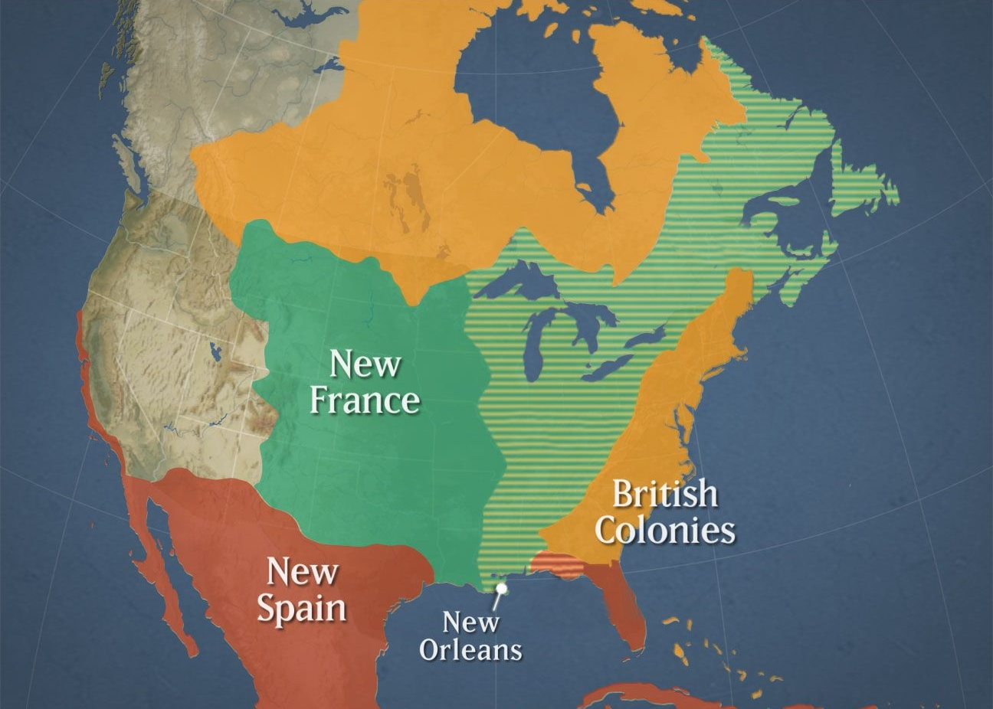
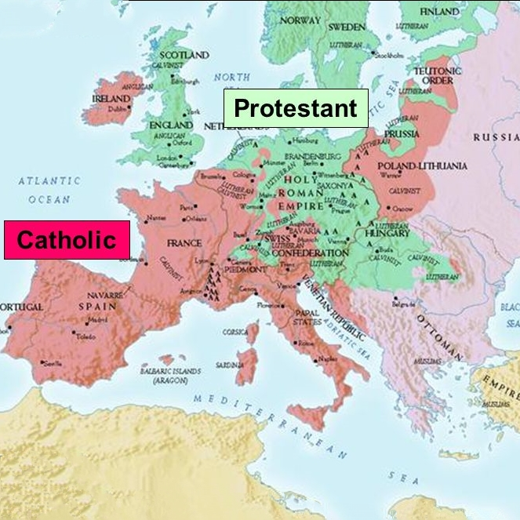
The Ascendency of Protestantism
When the British won the French & Indian War in 1763, the Protestantism of the American continent was virtually guaranteed.
By the late 17th century, major sections of Europe were predominantly Protestant.
Protestant

Slide 5
Utopianism
The industrial age led to a spirit of optimism in the early part of the 20th century.

Slide 6
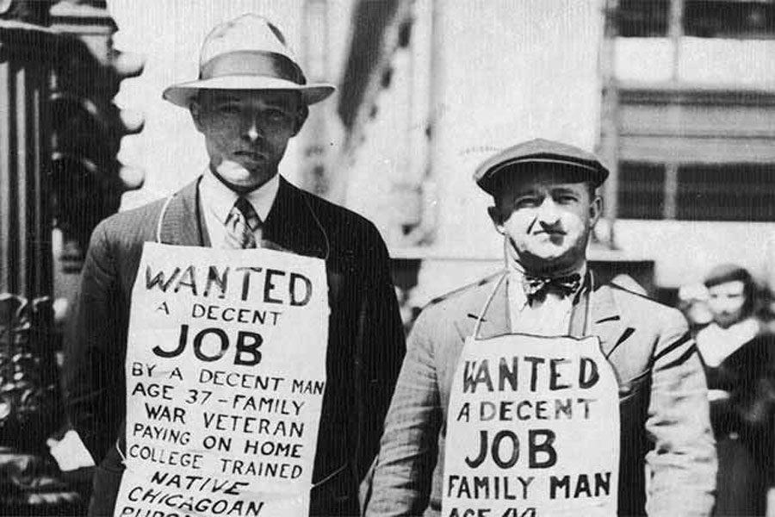
Depression and WWII
The Great Depression and World War Two put an end to the optimistic spirit of earlier years.

Slide 7
Chicago Statement on Biblical Inerrancy
2 Major Philosophical Factors:
Humanism
Relativism

Slide 8
Humanism
There are . . . many passages in the sacred volumes about which many commentators have made guesses, but no one has finally cleared up their obscurity: as the distinction between the divine persons, the conjunction of the divine and human nature in Christ . . . .
but no one has finally cleared up
their obscurity

Slide 9
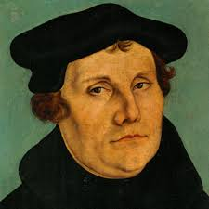
Humanism
The Holy Spirit is no Skeptic, and it is not doubts or mere opinions that he has written on our hearts, but assertions more sure and certain than life itself and all experience.

Slide 10
Relativism
The idea that truth is variable depending upon one’s worldview or perspective.
There is no objective truth.

Slide 11
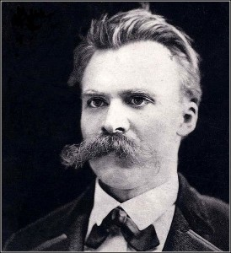
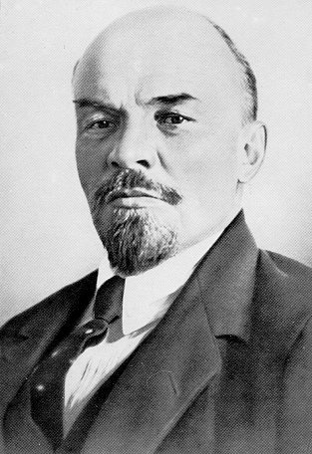
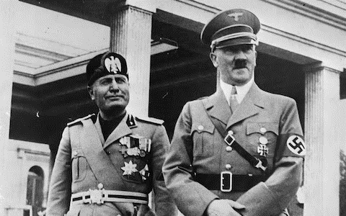
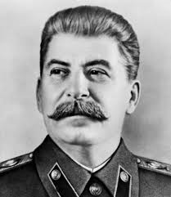
Family Tree of Relativism
Frederich Nietzsche
Vladimir Lenin
Benito Mussolini Adolph Hitler
Joseph Stalin

Slide 12
Chicago Statement on Biblical Inerrancy
4 Sign-posts of the Theological Landscape:
The Fundamentalist-Modernist Controversy
Seminary Drift
R.C. Sproul and Ligonier Ministries
The International Council on Biblical Inerrancy

Slide 13
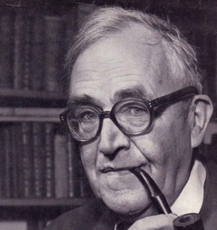
Fundamentalist-Modernist Debate
becomes
The Bible becomes the Word of God when it is sensed as being holy by the reader.
The concepts of the Bible are inspired, but not the words.
Karl Barth

Slide 14
Fundamentalist-Modernist Debate
In 1910, the Presbyterian Church in the USA affirmed the following 5 “Fundamentals”:
1. The inspiration and inerrancy of Scripture
2. The virgin birth of Christ
3. The death of Christ as an atonement for sin
4. The bodily resurrection of Christ
5. The historical reality of Christ's miracles

Slide 15
Seminary Drift
Harvard to Yale
Yale to Princeton
Princeton to Westminster
Fuller, Gordon-Conwell, Trinity

Slide 16
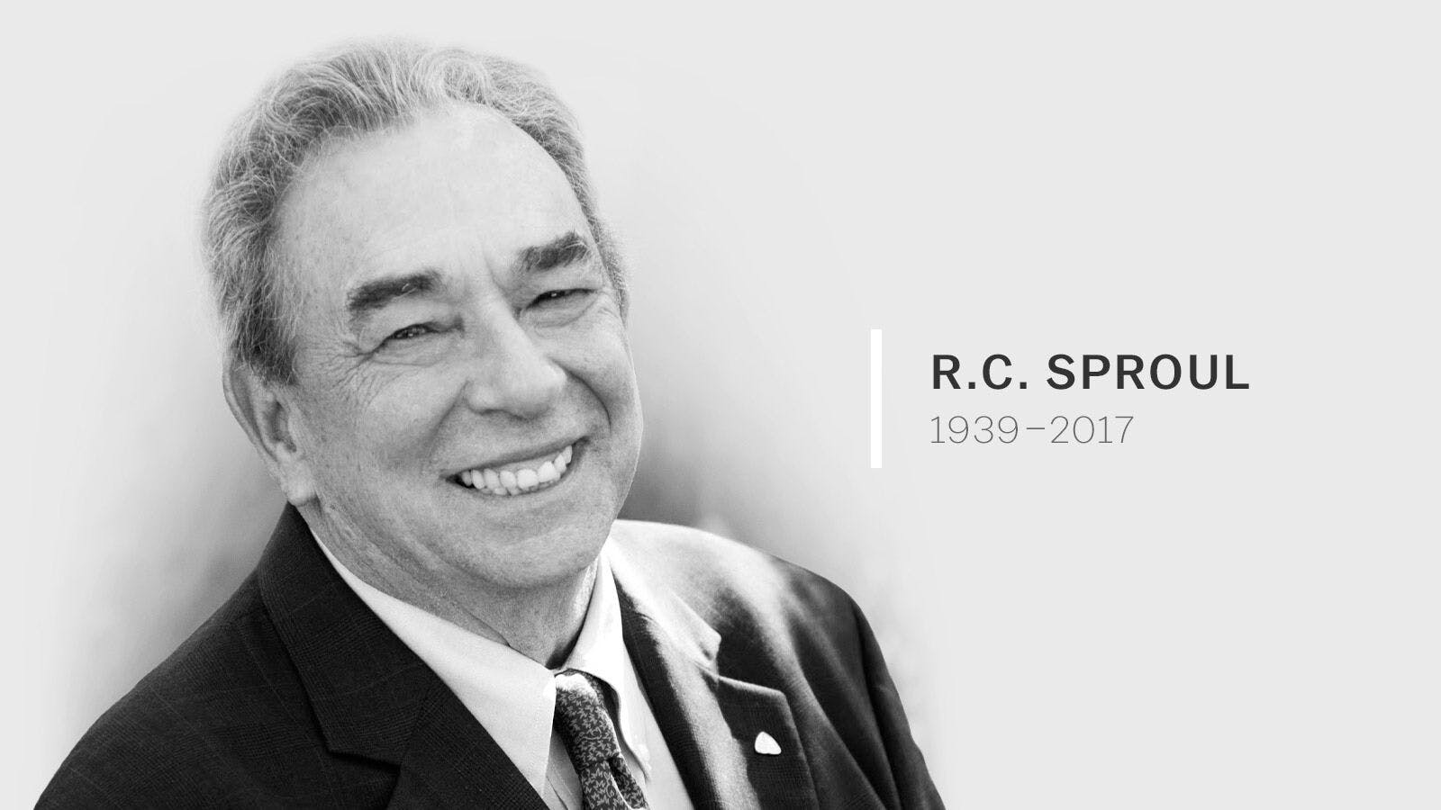
R.C. Sproul & Ligonier Ministries
R.C. Sproul started Ligonier Ministries in 1971 to distribute Bible teaching via publications, cassette recordings, and radio broadcasts.

Slide 17
Int’l Council on Biblical Inerrancy
The International Council on Biblical Inerrancy was convened in 1978 and was attended by 200 pastors and Bible scholars.
The product of a 3-day consultation was the Chicago Statement on Biblical Inerrancy.

Slide 18
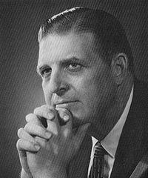
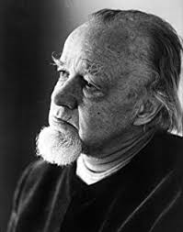
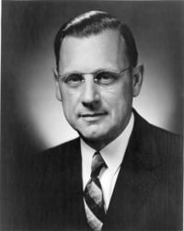
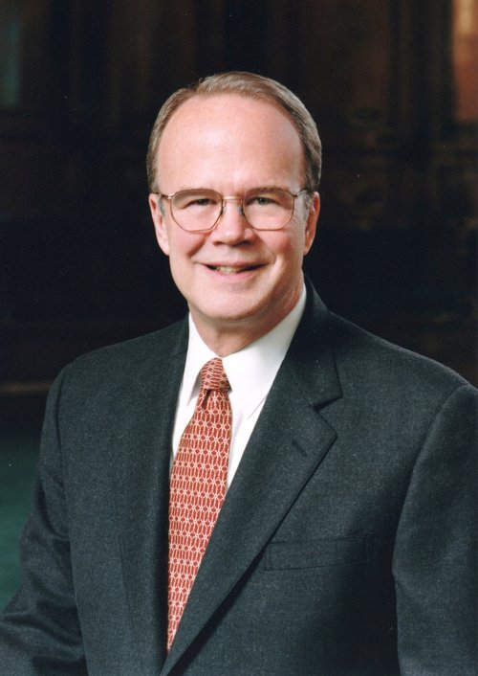
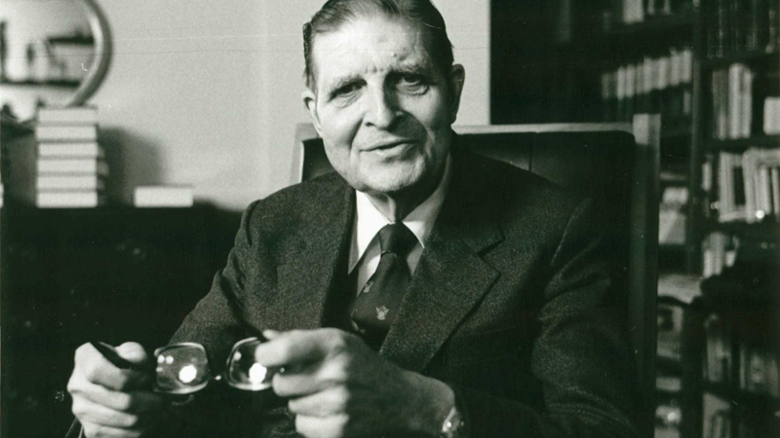
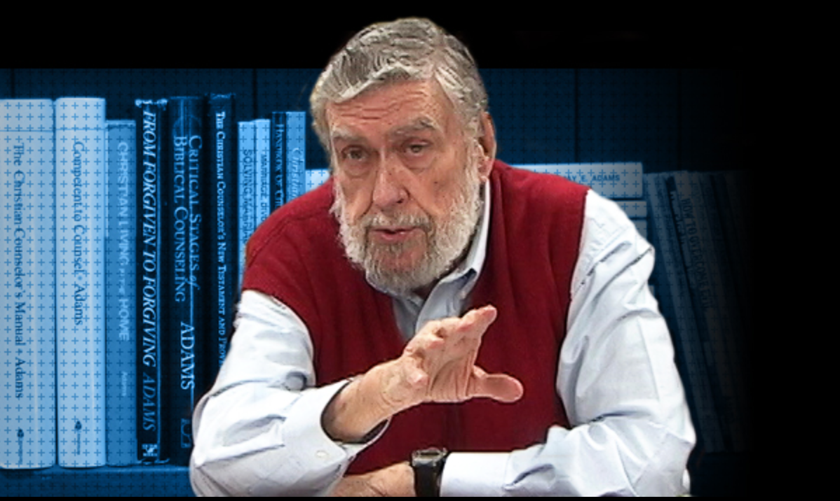
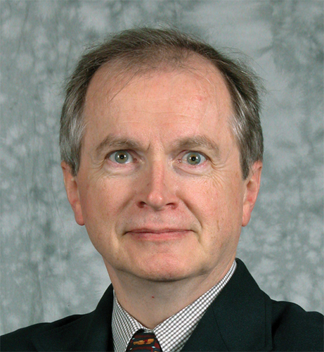
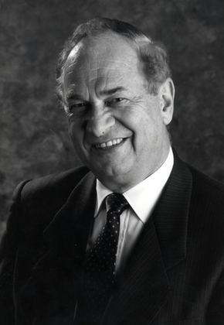
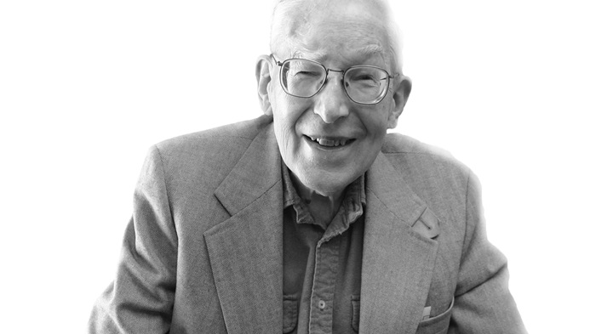
Int’l Council on Biblical Inerrancy
Francis Schaeffer
Harold John Ockenga
Harold Lindsell
Carl F. H. Henry
James Boice
D. James Kennedy
D.A. Carson
Jay Adams
J.I. Packer
Walter Kaiser, Jr.

