Slide 1
The Creeds of the Church
Session 12: The History of
the Confessional Statement of The Gospel Coalition

Slide 2
Introduction
Why study the Confessional Statement of
The Gospel Coalition?
2 Reasons:
It is recent in its formulation
It is broad in its scope

Slide 3
The Gospel Coalition
Factors contributing to TGC’s formation:
Relativism (on the left)
Fundamentalism (on the right)

Slide 4
The Gospel Coalition
Relativism
Just like the Chicago Statement on Biblical Inerrancy, TGC’s formation was, in part, a response to theological and moral relativism within some branches of evangelicalism.

Slide 5
The Gospel Coalition
Fundamentalism
By the mid-1900s, Fundamentalism had developed from its original, biblical roots into an amalgamation of dispensationalism, separationism, legalism, and conservative political activity.

Slide 6
The Gospel Coalition
Fundamentalism
Over time, Fundamentalists and Evangelicals differentiated themselves based, in part, on cultural emphases, and in part on theological emphases.
And Fundamentalists were generally on the fringe in American Christianity.

Slide 7
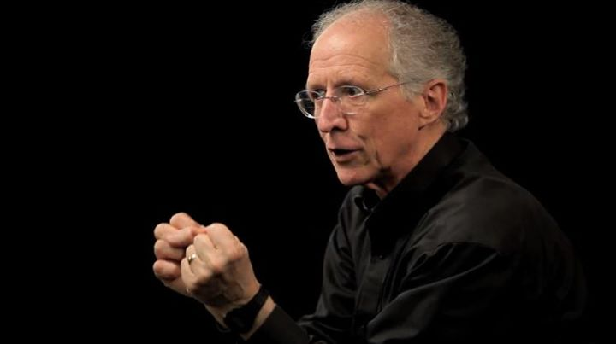
The Gospel Coalition
“…[H]e said that he was concerned that the voice of evangelicalism was often defined by the margins, by voices that were on the periphery of the gospel—very powerful voices, voices with huge churches and huge movements, but when they spoke they didn't speak from the center.”
John Piper

Slide 8
The Gospel Coalition
So TGC was formed to resist influences both from the theological left and from the theological right.

Slide 9
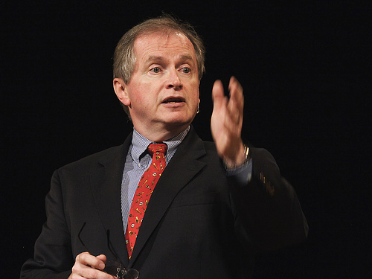
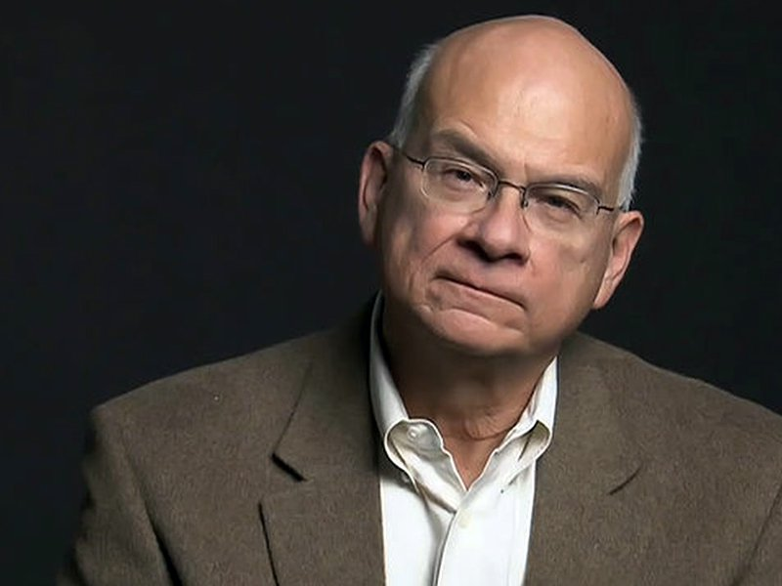
The Gospel Coalition
The Seeds of the Coalition
In 2002, D. A. Carson and Tim Keller started talking about the need for a new movement in American Evangelicalism, to return the focus to the gospel itself, rather than its implications.
D. A. Carson
Tim Keller

Slide 10
The Gospel Coalition
The original meetings of what became TGC were simply groups of pastors who came together for the purpose of mutual encouragement and prayer.

Slide 11
The Gospel Coalition
When they decided to move forward by holding national conferences, they began ironing out a confessional statement.

Slide 12
The Gospel Coalition
Their first conference was held in the Trinity Seminary chapel in 2007 and attended by 600 pastors and church leaders.

Slide 13
The Gospel Coalition
Today, TGC has retained its focus on re-centering the church on the gospel but it has shifted its means from thinking predominantly in terms of conferences to the distribution of other media.

Slide 14
The Gospel Coalition
Current Influence
The TGC website
2. International Outreach
3. The New City Catechism
4. Regional chapters
5. Themelios

Slide 15
The Gospel Coalition
The Confessional Statement
1. The identity and nature of God
2. The nature of Scripture
3. Creation
4. The Fall of humanity
5. God’s work of election
6. The nature of the gospel
7. The redemptive work of Christ
8. The justifying effect of Christ’s work
9. The redemptive work
of the Holy Spirit
10. The “already-not yet” nature of God’s Kingdom
11. The nature of the church
12. Baptism and the Lord’s Supper
13. The nature of the Consummation

