Slide 1
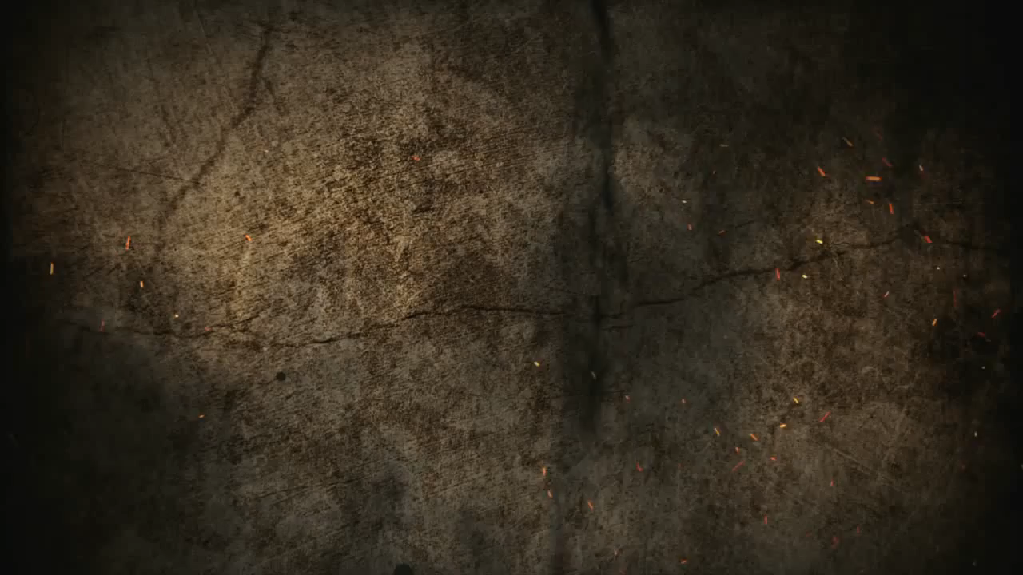
The Creeds of the Church
Session 3—The Theology of the Nicene Creed

Slide 2
Review: Orthodoxy and Heresy
What is “orthodoxy”?

Slide 3
Review: Orthodoxy and Heresy
Orthodoxy=“Right Teaching”
Orthodoxy is the set of beliefs that are central to the faith of the Christian church.

Slide 4
Tertiary
Doctrines
Secondary
Doctrines
Primary
Doctrines
Central
The Gospel

Slide 5
Review: Orthodoxy and Heresy
What is “heresy”?

Slide 6
Review: Orthodoxy and Heresy
Heresy=“Schism,” “Division”
Heresy=Heterodoxy or “different teaching”

Slide 7
Review: Orthodoxy and Heresy
By implication, heresy is the denial of orthodox doctrine.
The severity of the heresy is determined by how close to central the doctrine is that is denied.

Slide 8
Review: Orthodoxy and Heresy
Heresy ≠ Error

Slide 9
Review: Orthodoxy and Heresy
An error is only heresy if:
The error is a central, gospel issue
The error is primary AND persistent

Slide 10
Tertiary
Doctrines
Secondary
Doctrines
Primary
Doctrines
Central
The Gospel
Lack of belief in the resurrection of Jesus Christ from the dead

Slide 11
Tertiary
Doctrines
Secondary
Doctrines
Primary
Doctrines
Central
The Gospel
Belief that the Trinity represents different expressions of God’s being

Slide 12
Tertiary
Doctrines
Secondary
Doctrines
Primary
Doctrines
Central
The Gospel
Belief in infant baptism

Slide 13
Tertiary
Doctrines
Secondary
Doctrines
Primary
Doctrines
Central
The Gospel
Belief that women should not be teaching pastors in churches

Slide 14
Tertiary
Doctrines
Secondary
Doctrines
Primary
Doctrines
Central
The Gospel
Belief that the Bible contains God’s Word but also some errors

Slide 15
Tertiary
Doctrines
Secondary
Doctrines
Primary
Doctrines
Central
The Gospel
Belief that the earth evolved

Slide 16
Tertiary
Doctrines
Secondary
Doctrines
Primary
Doctrines
Central
The Gospel
Belief that only the Psalms should be sung in church

Slide 17
Tertiary
Doctrines
Secondary
Doctrines
Primary
Doctrines
Central
The Gospel
Belief in believer’s baptism

Slide 18
Tertiary
Doctrines
Secondary
Doctrines
Primary
Doctrines
Central
The Gospel
Belief that only those baptized as believers can be saved

Slide 19
Review: Orthodoxy and Heresy
With these understandings in mind, we can see why Arianism (and Macedonianism) were such big issues for the fourth century church.

Slide 20
Tertiary
Doctrines
Secondary
Doctrines
Primary
Doctrines
Central
The Gospel
Arianism—the Son is not divine
Macedonianism—the Holy Spirit is not divine

Slide 21
The Nicene Creed

Slide 22
We believe in one God,
the Father Almighty,
Maker of heaven and earth,
of all things visible and invisible.

Slide 23
And in one Lord Jesus Christ,
the only Son of God,
begotten from the Father before all ages
begotten

Slide 24
Hebrews 11:17 By faith Abraham, when he was tested, offered up Isaac, and he who had received the promises was offering up his only begotten son.

Slide 25
God from God,
Light from Light,
true God from true God,
begotten, not made;
of the same essence as the Father.
Through him all things were made.
essence

Slide 26
For us and for our salvation
he came down from heaven;
he became incarnate by the Holy Spirit and the virgin Mary, and was made human.
He was crucified for us under Pontius Pilate;
he suffered and was buried.
The third day he rose again, according to the Scriptures.
He ascended to heaven
and is seated at the right hand of the Father.
He will come again with glory
to judge the living and the dead.
His kingdom will never end.

Slide 27
And we believe in the Holy Spirit,
the Lord, the giver of life.
He proceeds from the Father and the Son,
and with the Father and the Son is worshiped and glorified.
He spoke through the prophets.

Slide 28
We believe in one holy catholic and apostolic church.
We affirm one baptism for the forgiveness of sins.
We look forward to the resurrection of the dead,
and to life in the world to come.
Amen.

